Slide 1
MYFutureJobs Insights
Skills insights on 19680 jobs from MyFutureJobs portal

Slide 2
Education Requirement
Education | Count | Percentage (%)
Primary Education | 741 | 3.77
PMR / PT3 | 1356 | 6.89
SPM / O Level / SKM | 8065 | 40.98
STPM / A Level | 460 | 2.34
Diploma / DVM | 4941 | 25.11
Bachelor’s | 3962 | 20.13
Master’s | 96 | 0.49
Doctoral (PhD) | 59 | 0.30

Slide 3
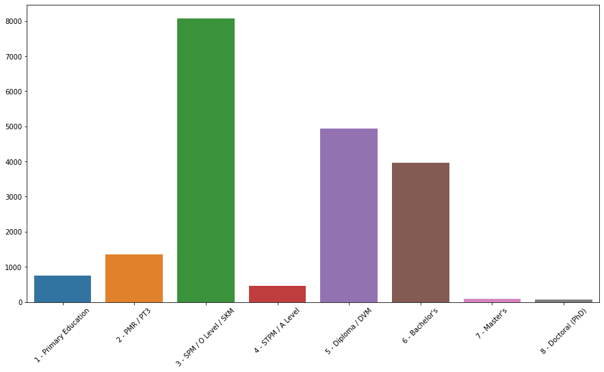
Education Requirement

Slide 4
Job Description Language
Language | Count | Percentage (%)
English | 16950 | 86.13
Others | 2730 | 13.87

Slide 5
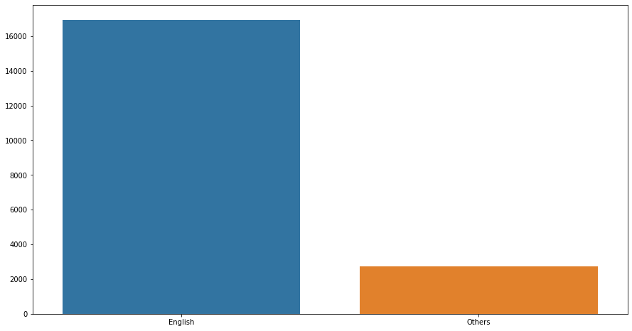
Job Description Language

Slide 6
Number of Skills
 | Number of Skills
Mean | 5.59
Min | 0
1st Quartile (Q1) | 1
Median (Q2) | 3
3rd Quartile (Q3) | 7
Max | 53
Has At Least 1 Skill | Count | Percentage (%)
True | 16962 | 86.19
False | 2718 | 13.81

Slide 7
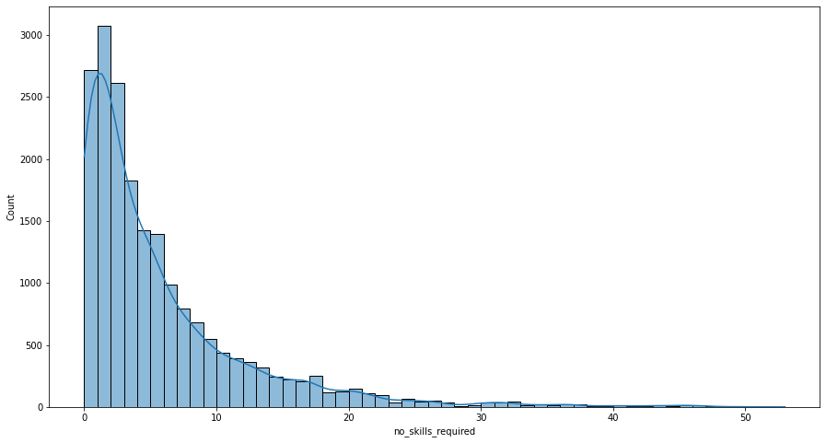
Number of Skills Distribution

Slide 8
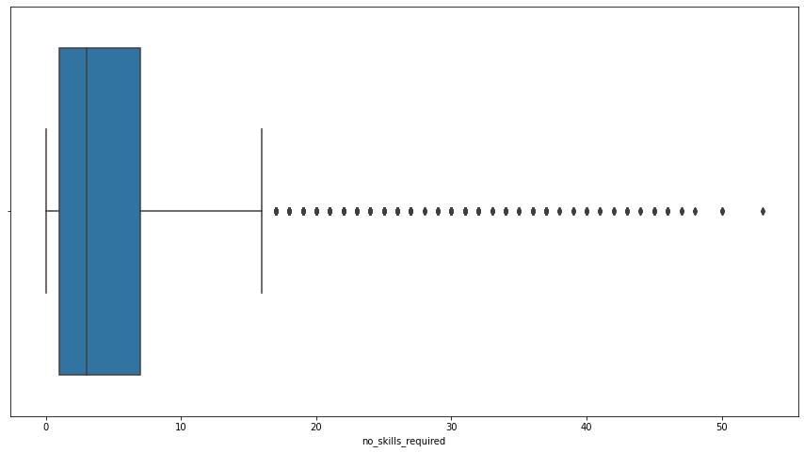
Number of Skills Boxplot

Slide 9
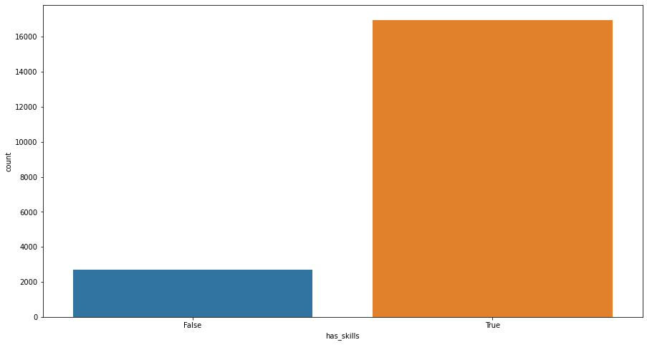
Having At Least 1 Skill

Slide 10
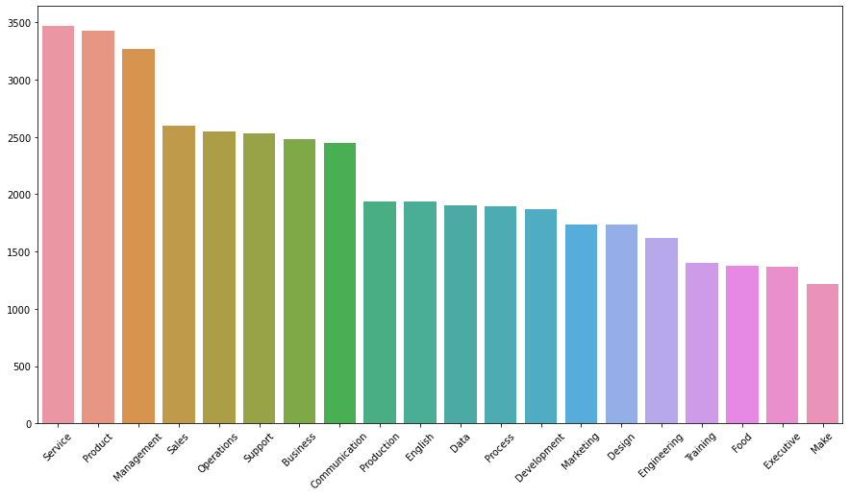
Top 20 Most Common Skills

Slide 11
Education

Slide 12
Job Description in English
Education | Count | Percentage (%)
Primary Education | 623 | 84.08
PMR / PT3 | 1153 | 85.03
SPM / O Level / SKM | 6955 | 86.24
STPM / A Level | 387 | 84.13
Diploma / DVM | 4256 | 86.16
Bachelor’s | 3441 | 86.85
Master’s | 83 | 86.46
Doctoral (PhD) | 51 | 86.44

Slide 13
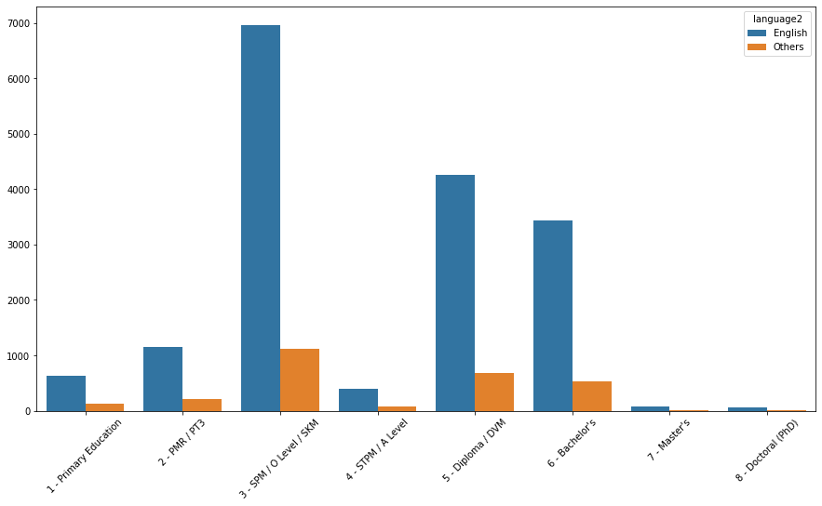
Job Description Language

Slide 14
Skills
Education | Mean | Count Having At Least 1 Skill | Percentage Having At Least 1 Skill (%)
Primary Education | 6.49 | 625 | 84.35
PMR / PT3 | 6.28 | 1170 | 86.28
SPM / O Level / SKM | 6.74 | 6917 | 85.76
STPM / A Level | 6.77 | 383 | 83.26
Diploma / DVM | 6.70 | 4295 | 86.93
Bachelor’s | 7.07 | 3439 | 86.80
Master’s | 6.38 | 82 | 85.42
Doctoral (PhD) | 6.18 | 51 | 86.44

Slide 15
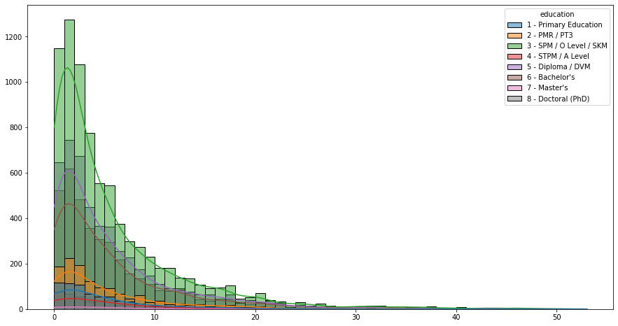
Number of Skills Distribution

Slide 16
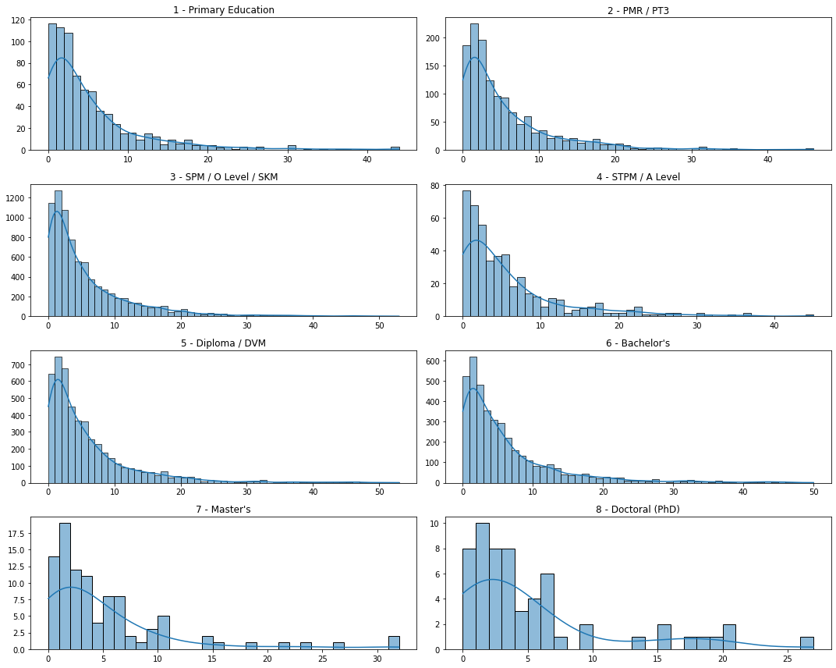
Number of Skills Distribution

Slide 17
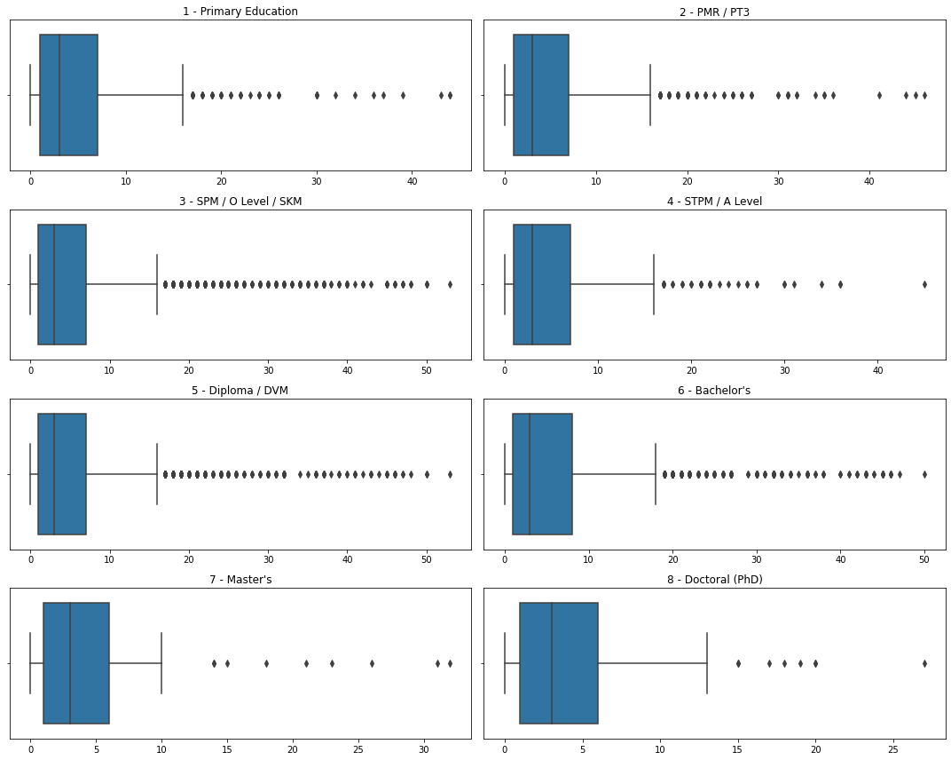
Number of Skills Boxplot

Slide 18
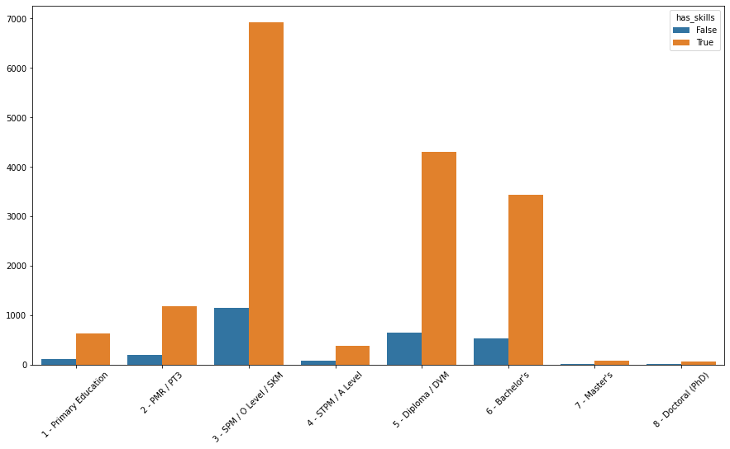
Having At Least 1 Skill

Slide 19
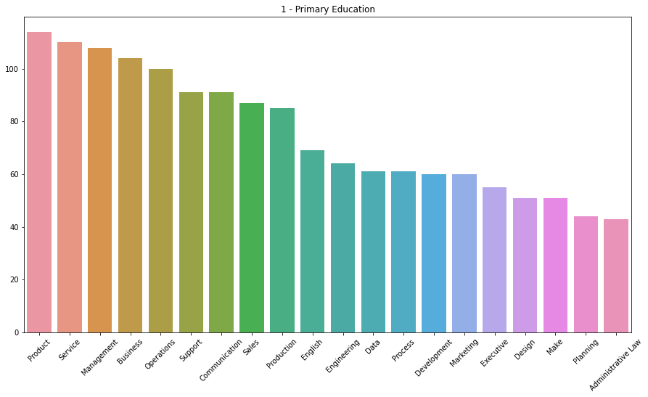
Top 20 Most Common Skills – Primary Education

Slide 20
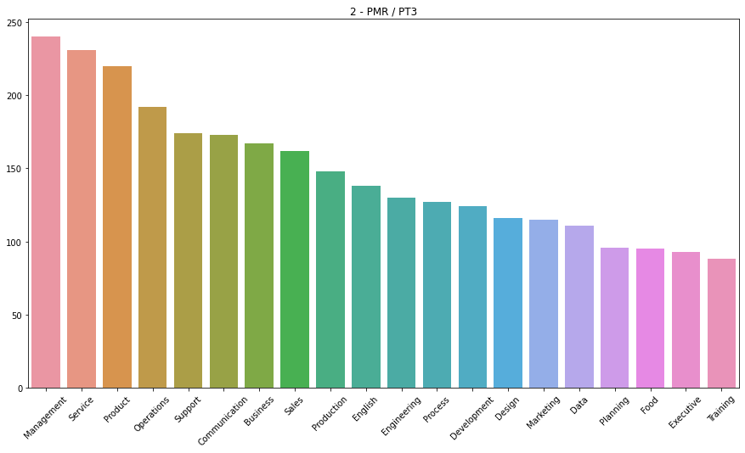
Top 20 Most Common Skills – PMR / PT3

Slide 21
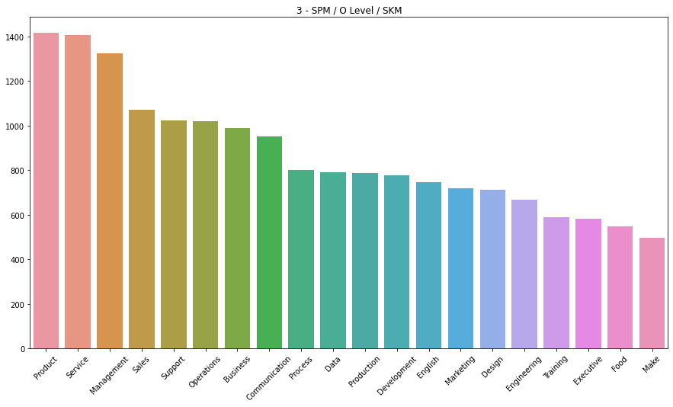
Top 20 Most Common Skills – SPM / O Level / SKM

Slide 22
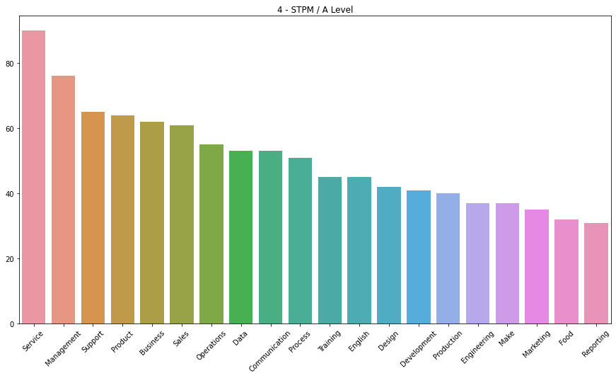
Top 20 Most Common Skills – STPM / A Level

Slide 23
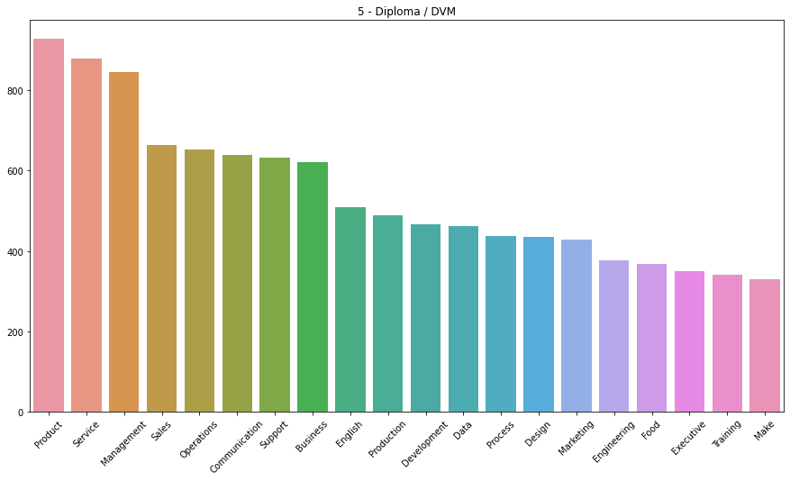
Top 20 Most Common Skills – Diploma / DVM

Slide 24
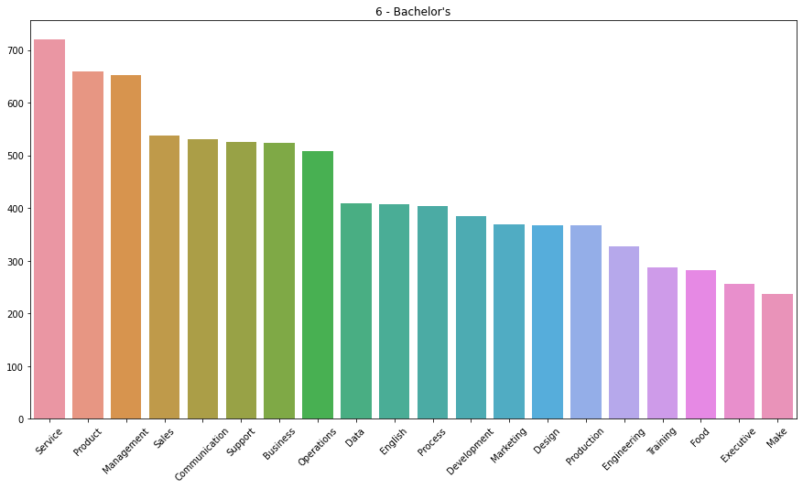
Top 20 Most Common Skills – Bachelor’s

Slide 25
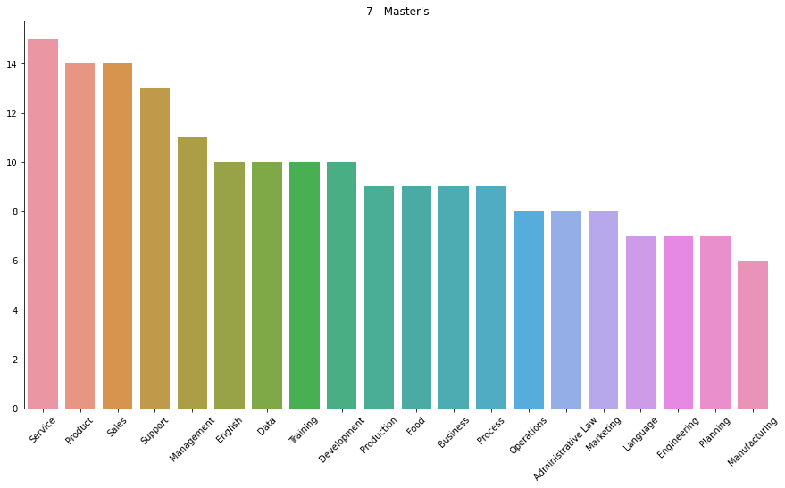
Top 20 Most Common Skills – Master’s

Slide 26
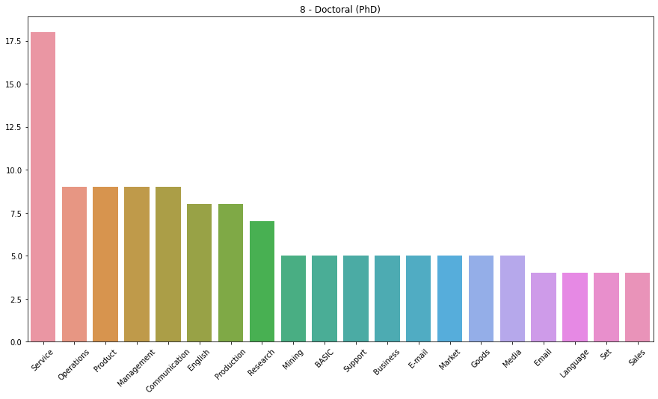
Top 20 Most Common Skills – Doctoral (PhD)

Slide 27
Language

Slide 28
Skills
Language | English | Others
Mean | 6.35 | 0.90
Count Having At Least 1 Skill | 15652 | 1310
Percentage Having at Least 1 Skill (%) | 92.34 | 47.99

Slide 29
Number of Skills
 | Number of Skills
Mean | 5.59
Min | 0
1st Quartile (Q1) | 1
Median (Q2) | 3
3rd Quartile (Q3) | 7
Max | 53
Has At Least 1 Skill | Count | Percentage (%)
True | 16962 | 86.19
False | 2718 | 13.81

Slide 30
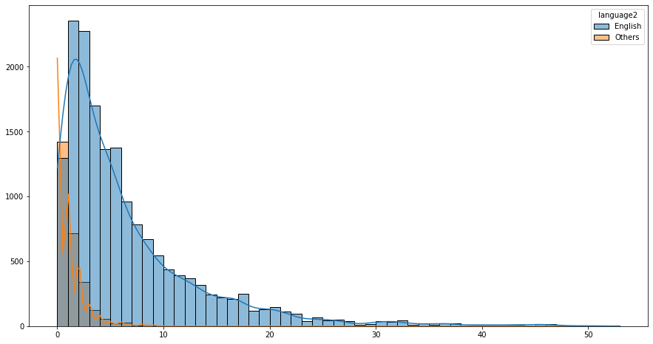
Number of Skills Distribution

Slide 31
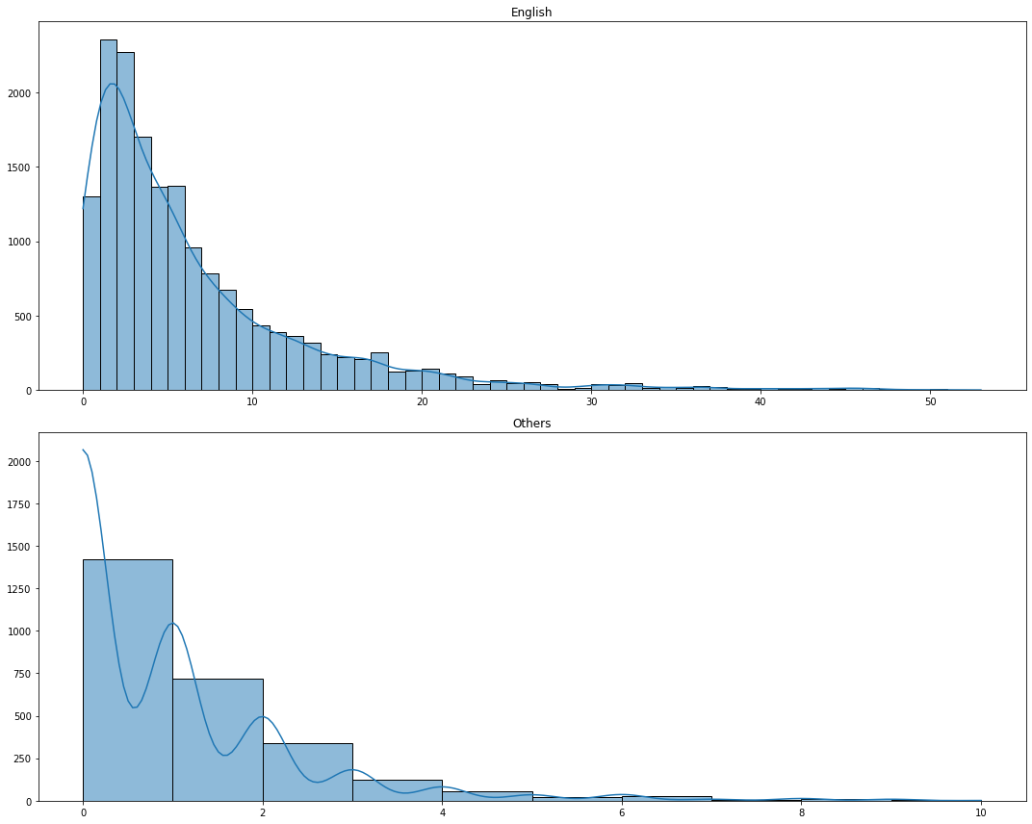
Number of Skills Distribution

Slide 32
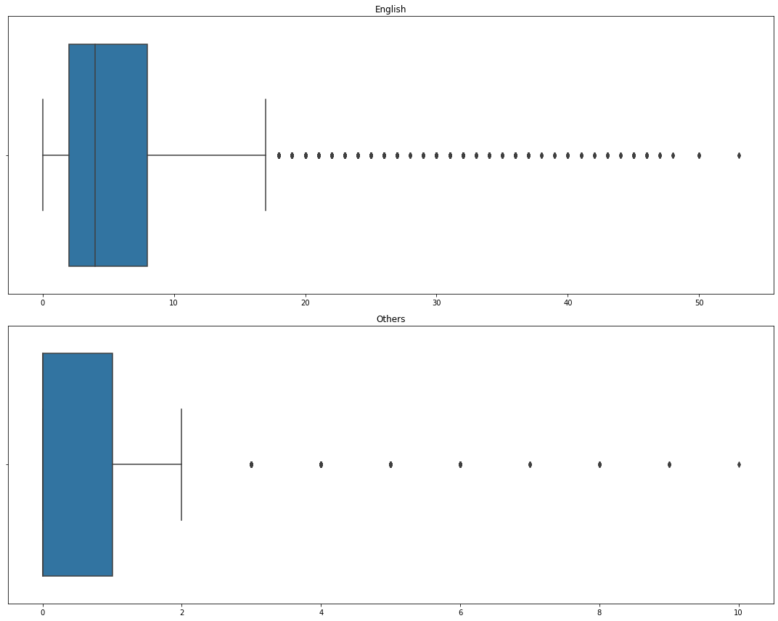
Number of Skills Boxplot

Slide 33
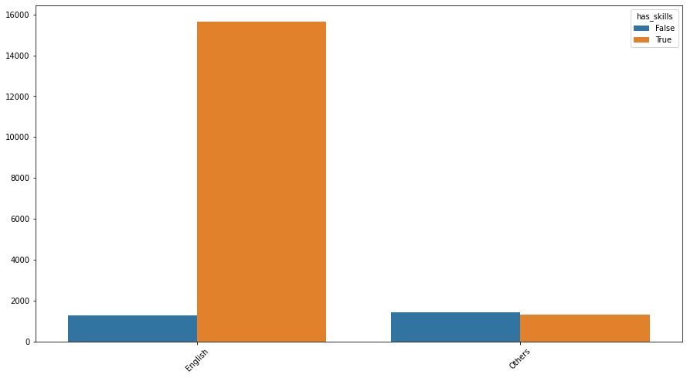
Having At Least 1 Skill

Slide 34
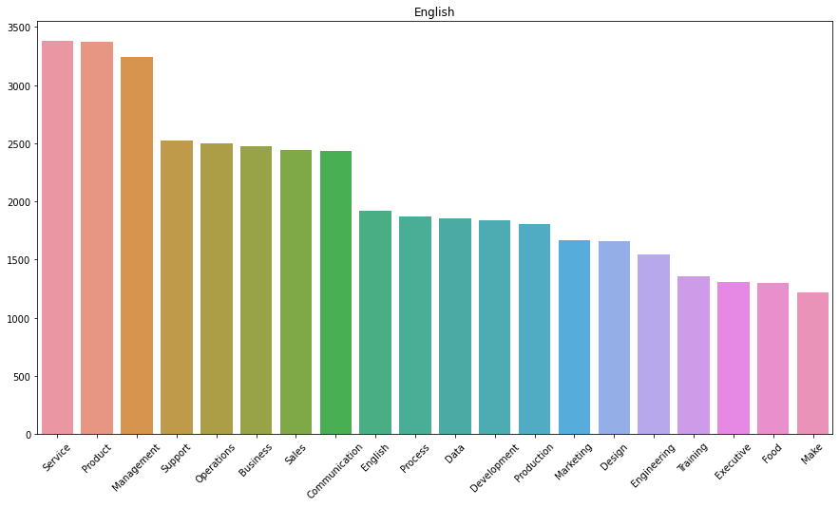
Top 20 Most Common Skills – English

Slide 35
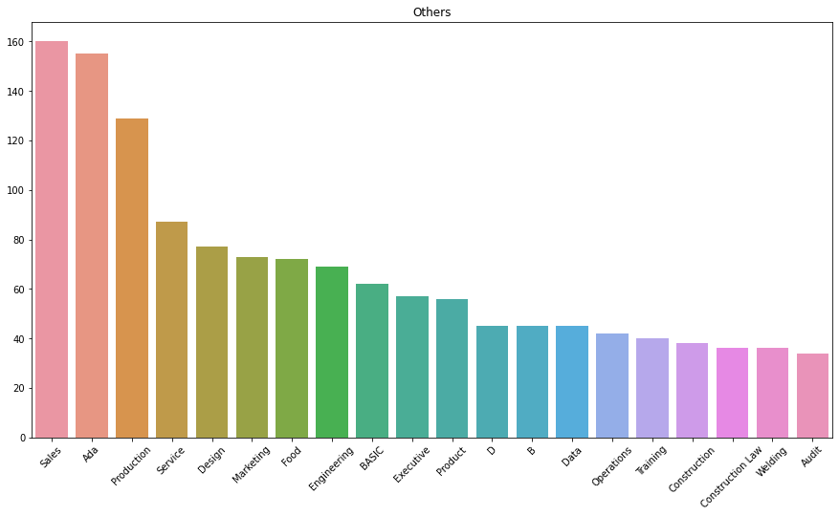
Top 20 Most Common Skills – Others

Slide 36
Word Cloud

Slide 37
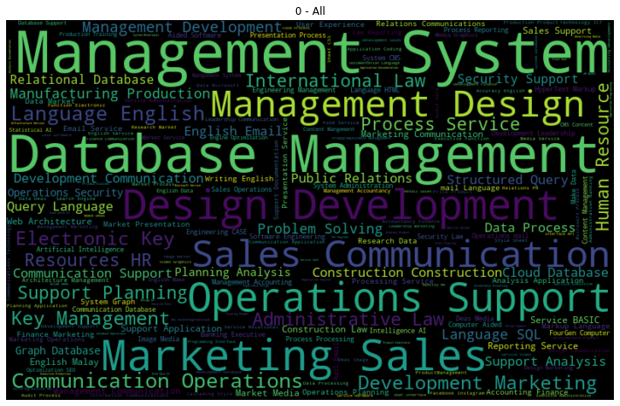
All Jobs

Slide 38
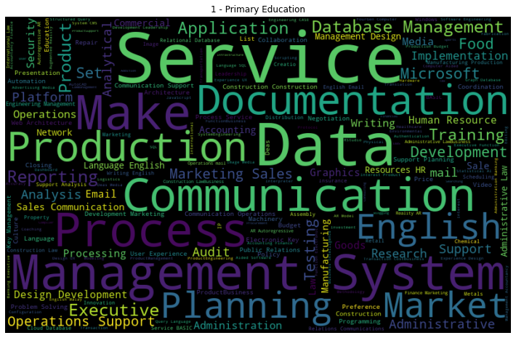
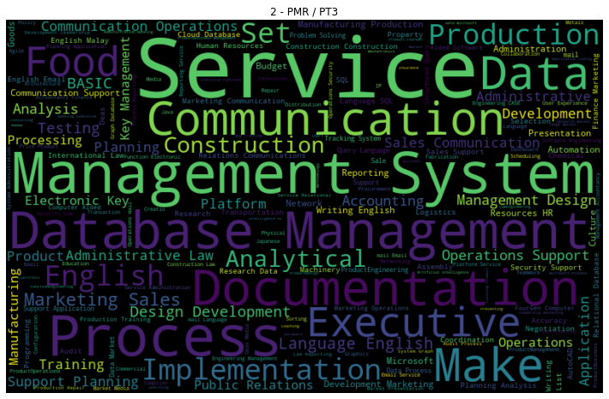
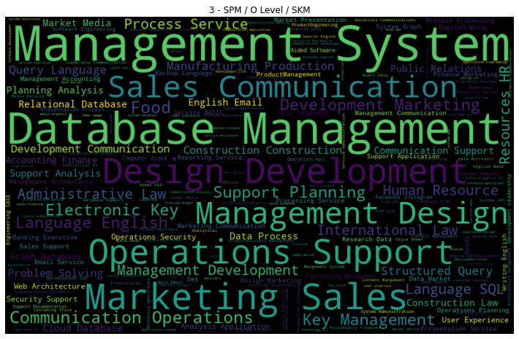
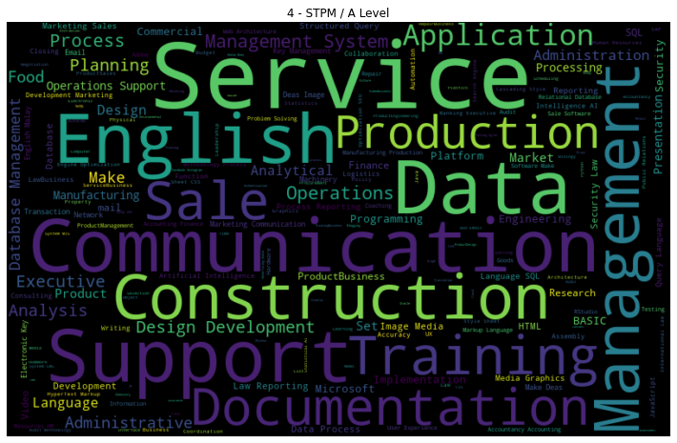

Slide 39
